Slide 1


GYM MANAGEMENT SYSTEM

Slide 2

OVERVIEW
This project, Gym Management System caters to both online and offline users. Online users have access to premium workout videos, purchase gym supplements through secure payments.
Offline users can mark their attendance and choose preferred trainers. Users can mark their
attendance through the system replacing traditional manual methods.
The system also provides an administrative interface for managing trainers, supplements with its relevant links.
Users can provide feedback which can be viewed by admin.
As a whole, Gym Management System aims to streamline operations, enhance user satisfaction and simplify administrative tasks that happens in a gym.

Slide 3
REQUIREMENTS
USERS
Profile management.
Can give feedback.
Manage gym member attendance.
Videos can be viewed after paying for it.
View supplements and buy it using the link provided.
ADMIN
Courses video management.
Gym supplements management.
Manage Trainers.
View Feedback.
View Attendance.

Slide 4

FEATURES AND HIGHLIGHTS
Online Access to Premium Workout Videos: Users can conveniently access a diverse selection of premium workout videos after payment.
E-commerce Functionality :The system includes an e-commerce module, enabling users to conveniently shop for gym accessories directly from the website.
Attendance Tracking for Offline Users: Offline users can electronically mark their attendance,
eliminating manual tracking and improving efficiency.
Customized Trainer Selection: Offline users can customize their workout experience by choosing their preferred trainers from a list provided by the admin.

Slide 5
Streamlined Gym Operations: The Gym Management System combines online and offline functionalities to streamline gym operations, including video access, e-commerce, attendance tracking, and trainer selection, for improved efficiency.
Enhanced User Satisfaction: The gym management system aims to enhance user satisfaction by providing online video access, convenient e-commerce options, and personalized trainer selection.
Simplified Administrative Tasks: The system streamlines administrative tasks by offering an intuitive interface for managing trainers, supplements, and related information.
Admin Control and Management: The administrative interface enables seamless system
management for the admin. They have the authority to effortlessly add and update trainer
details, including qualifications, experience, and availability.

Slide 6

THIRD-PARTY LIBRARIES
The third party libraries used in my project is:
Stripe API: The Stripe API provides a wide range of functionalities, making it easy to handle
various payment-related tasks programmatically. It is a popular payment gateway that allows businesses to accept online payments securely and efficiently.
Django Jazzmin : a drop in app to jazz up your Django admin site, with plenty of things you can
easily customize, including a built-in UI customizer.
Pillow: It refers to a popular Python imaging library that provides support for image processing tasks within Django web applications.
Bootstrap:Bootstrap is the most popular CSS Framework for developing responsive and
mobile-first websites.

Slide 7
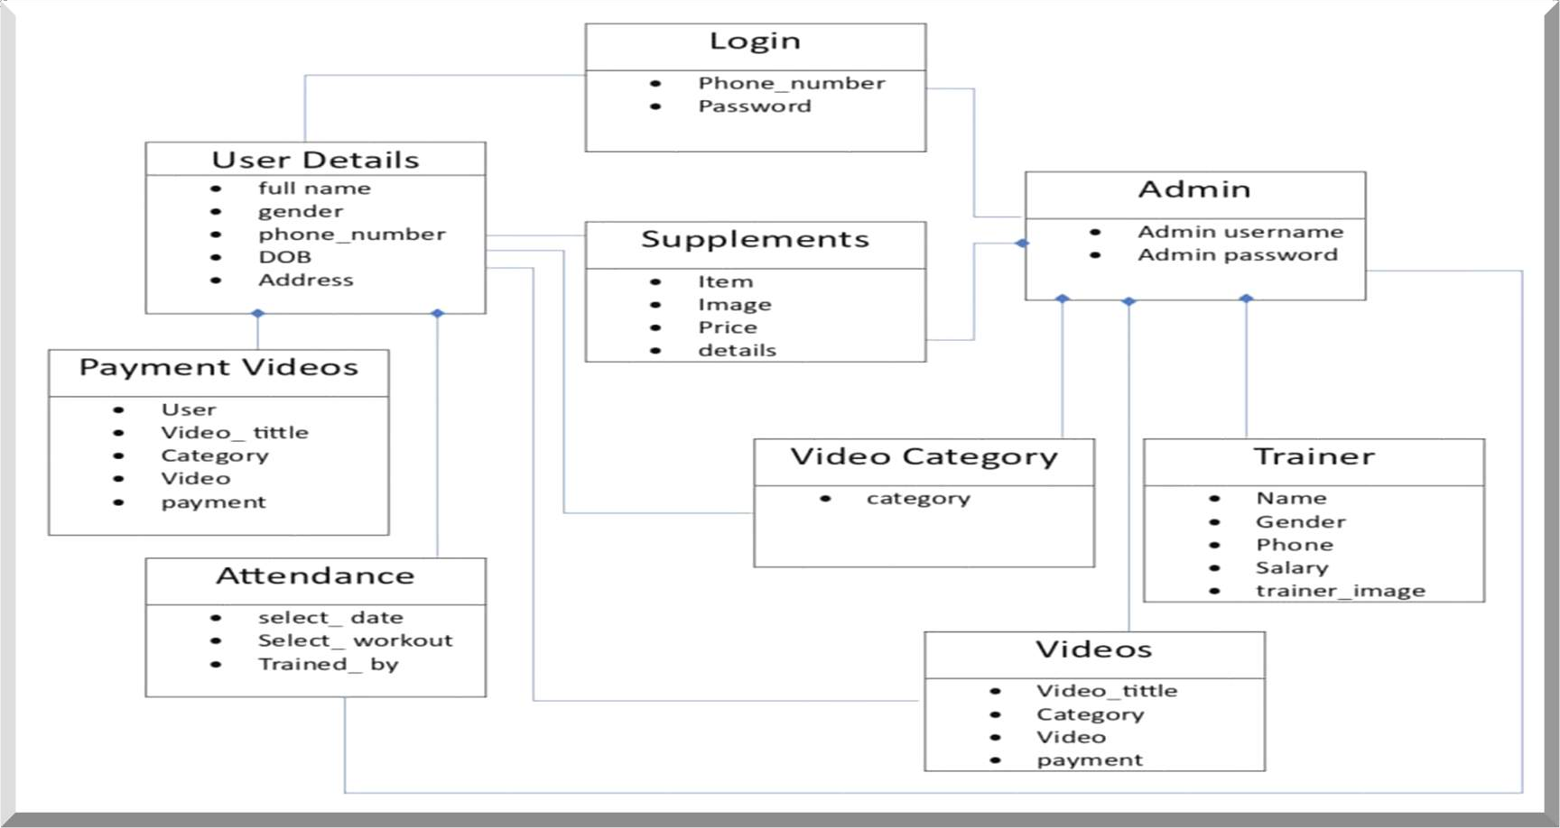
CLASS DIAGRAM

Slide 8

CHALLENGES FACED
Handling checkout and secure payment.
Creating a user-friendly interface that is intuitive and easy to navigate.
I had faced difficulties in using and learning about the third-party libraries like(Stripe API, Django Jazzmin, Pillow, Bootstrap) Had to refer to different documentations to get a good understanding about these libraries.

Slide 9

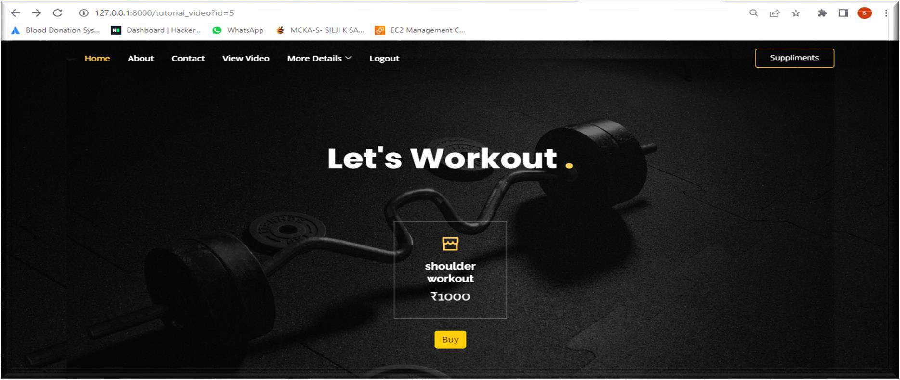

SCREENSHOTS
After successful login, the user can select from the options provided. Click on anyone of it and you will be redirected to this page where you can view the workout details and course fee.

Slide 10
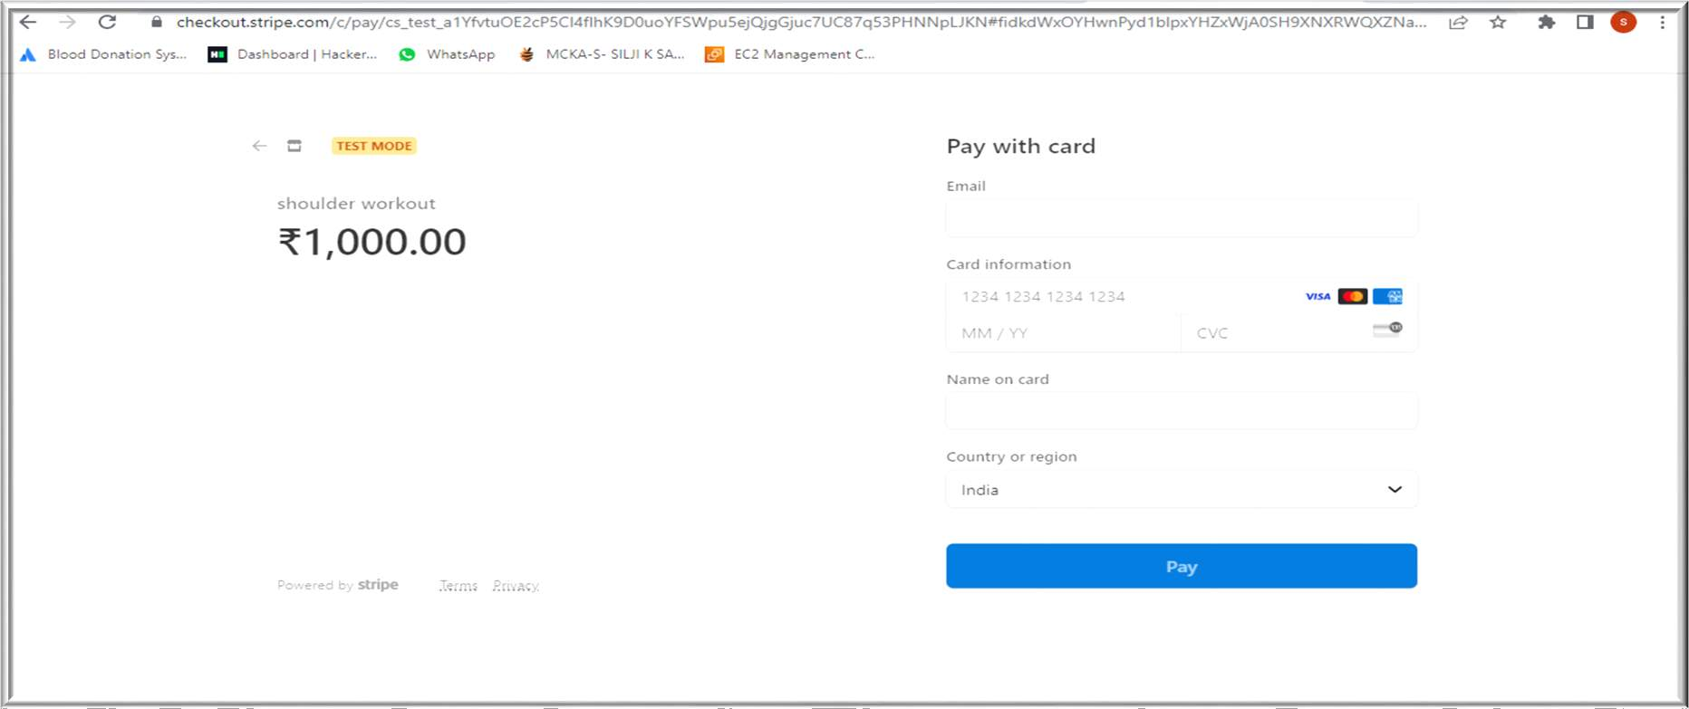
After entering necessary payment details,the process is done.

Slide 11
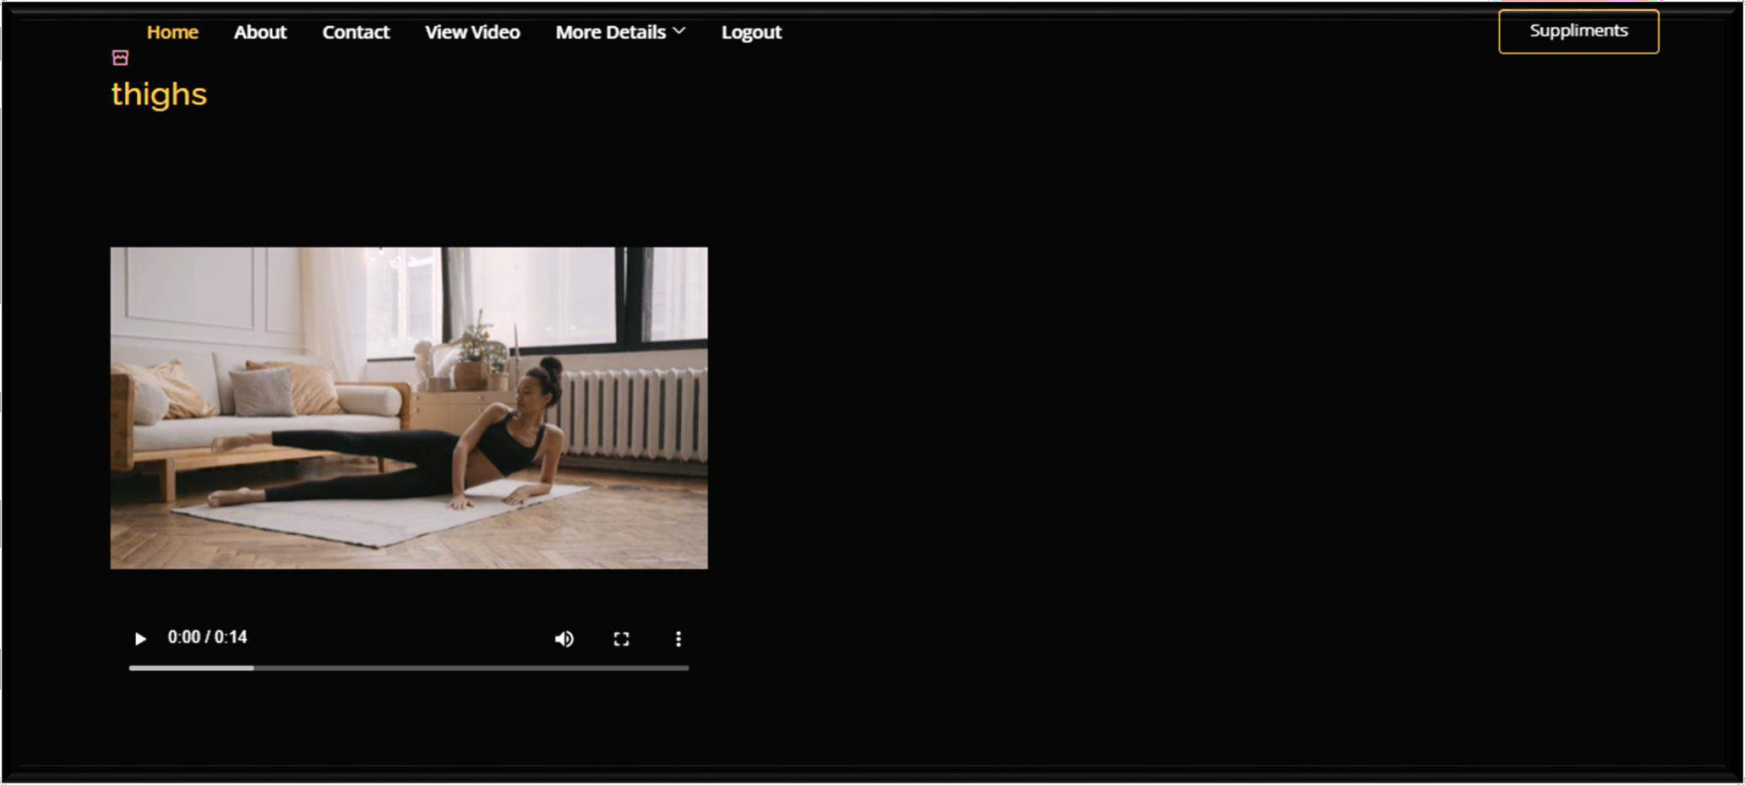
After successful payment,user is redirected to view the video.

Slide 12
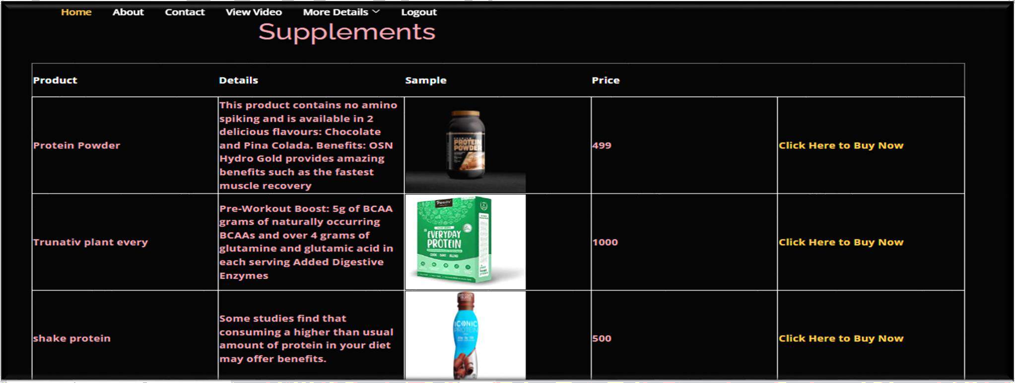
If any supplements needed to be purchased,click on the link given and you will be redirected to a shopping site.

Slide 13

FUTURE ENHACEMENTS
product purchase:The users will be able to purchase supplements from the site itself. The
products will be added by admin.
OTP Verification :After the successful registration process , It generate a unique verification code to the user's provided email address or phone number.
Mobile Application :Enhancing user-friendliness can be achieved by introducing a mobile application as part of the gym management system.

Slide 14

CONCLUSION
Gym management system offers a robust platform for enhancing the gym experience. Overcoming the traditional method of marking attendance, the offline users can do that in the website while online users can view videos after paying for it. The gym supplements can be purchased using the site .Admin adds the trainers and users can select the preferred trainers. Online users can manage their profile by modifying it whenever needed. These features collectively enhance convenience, efficiency, and personalization, elevating the overall gym experience for both online and offline users.

Slide 15

REFERENCES
https://www.gymmaster.com/
https://gymdesk.com/
https://www.exercise.com/
https://stripe.com/docs/payments/accept-a-payment

Slide 16

THANK YOU

